Slide 1
Square Matrix
Properties
1 : I == J
2 : Diagonal matrix
3 : Transposed matrix
4 : Inverse matrix
5 : orthogonal matrix

Slide 2



Inverse Matrix
M = S . R
$M^{−1}$ = ${(S . R)}^{−1}$
$M^{−1}$ = $R^{−1}. S^{−1}$
I = M . $M^{−1}$

Slide 3
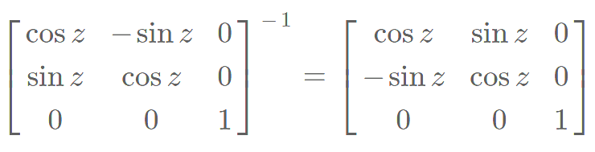
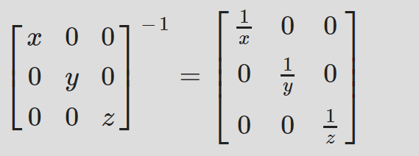
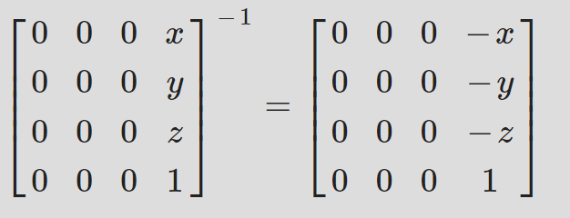
Matrix - Inverse
1
Rotation Inverse
Scale Inverse
Unity Provides an object’s
world-to-object matrix
Reposition Inverse

Slide 4


Transpose Matrix
M = S . R
$M^{T}$ = ${(S . R)}^{T}$
$M^{T}$ = $R^{T}. S^{T}$
I = M . $M^{−1}$

Slide 5


Orthogonal Matrix
I = M . $M^{T}$
$$M^{T}=M^{−1}$$
Rotation Matrix

Slide 6
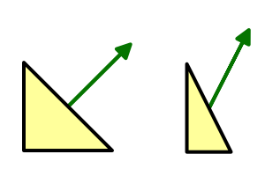
1
Matrix - Inverse
Scaling X, both vertices and normals by ½.

Slide 7
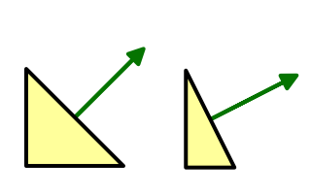
1
Matrix - Inverse
Scaling X, vertices by ½ and normals by 2.

Slide 8

y
Nb : -2, 1
Na : -1, 1
Tb : 0.5, 1
Ta: 1, 1
X
Tb
M
Ta
Tb = M * Ta
0.5
0.5
0
1
Nb = M` * Na
=
1
0
1
1
Tb . Nb = 0
Ta . Na = 0
Nb
M`
Na
$$M = M^{−1}$$
-2
2
0
-1
=
1
0
1
1

Slide 9





M = S . R
Inverse Matrix
$M^{−1}$ = ${(S . R)}^{−1}$
$M^{−1}$ = $R^{−1}. S^{−1}$
${{(M}^{−1})}^{T}$ = ${{(R}^{−1}. S^{−1}\text{)}}^{T}$
${{(M}^{−1})}^{T}$ = ${(S^{−1}\text{)}}^{T} .{(R^{−1}\text{)}}^{T}$
M` = $S^{−1}$ . R

Slide 10


1
y
Matrix Rotation
X1, y1
R
X0, y0
Rotate around Z Axis
$$β$$
$$α$$
X
$$x1= rcos\left(α+β\right)=r(\cos\left(a\right)\cos\left(β\right)−\sin\left(a\right)sin⁡(β))$$
$$y1= rsin\left(α+β\right)=r(\sin\left(a\right)\cos\left(β\right)+ \cos\left(a\right)sin⁡(β))$$
$$x1= rcos\left(α+β\right)=X0\cos\left(β\right)−Y0sin⁡(β)$$
$$y1= rsin\left(α+β\right)=X0\sin\left(β\right)+ Y0cos\left(β\right)$$
X1
Cos
-Sin
X0
=
Y1
Sin
Cos
Y0

Slide 11



Quaternion why using 4X4
Rotation, Scale -> Linear
$$\begin{matrix}1 & 0 & 0 \\ 0 & 1 & 0 \\ 0 & 0 & 1\end{matrix}$$
$$\begin{matrix}k & 0 & 0 \\ 0 & k & 0 \\ 0 & 0 & k\end{matrix}$$
K
=
Transformation -> Not Linear
1 0 0 2
X
Y
Z
1
X + 2
Y + 3
Z + 4
1
F(x) = x + |1, 2, 3|
F(x) + F(x) = F(x+ x)
0 1 0 3
=
0 0 1 4
Solution
$$\begin{matrix}M3x3 & T3x1 \\ 01x3 & 1\end{matrix}$$
0 0 0 1

Slide 12
4
Matrix Rotation
Unity Left-handed coordinate system

Slide 13
2
Matrix Rotation
Z
Y1, Z1
Y0, Z0
Rotate around X Axis
$$β$$
$$α$$
Y
$$Y1= rcos\left(α+β\right)=r(\cos\left(a\right)\cos\left(β\right)−\sin\left(a\right)sin⁡(β))$$
$$Y1= rcos\left(α+β\right)=Y0\cos\left(β\right)−Z0sin⁡(β)$$
$$Z1= rsin\left(α+β\right)=r(\sin\left(a\right)\cos\left(β\right)+ \cos\left(a\right)sin⁡(β))$$
$$Z1= rsin\left(α+β\right)=Y0\sin\left(β\right)+ Z0cos\left(β\right)$$
Y1
Cos
-Sin
Y0
=
Z1
Sin
Cos
Z0

Slide 14
3
Matrix Rotation
X
Z1, X1
Z0, X0
Rotate around Y Axis
$$β$$
$$α$$
Z
$$Z1= rcos\left(α+β\right)=r(\cos\left(a\right)\cos\left(β\right)−\sin\left(a\right)sin⁡(β))$$
$$Z1= rcos\left(α+β\right)=Z0\cos\left(β\right)−X0sin⁡(β)$$
$$X1= rsin\left(α+β\right)=r(\sin\left(a\right)\cos\left(β\right)+ \cos\left(a\right)sin⁡(β))$$
$$X1= rsin\left(α+β\right)=Z0\sin\left(β\right)+ X0cos\left(β\right)$$
Z1
Cos
-Sin
Z0
=
X1
Sin
Cos
X0

Slide 15
5
Matrix Rotation
Rotate around Z
X - > Y
Cos
-Sin
0
X0
Cos * X0 + (-Sin) * Y0 + 0 * Z0
Cos * X0 + (-Sin) * Y0
Sin
Cos
0
Y0
=
Sin * X0 + Cos * Y0 + 0 * Z0
=
Sin * X0 + Cos * Y0
0
0
1
Z0
0 * X0 + 0 * Y0 + 1 * Z0
Z0
Rotate around X
Y - > Z
1 0 0
X0
1 * X0 + 0 * Y0 + 0 * Z0
X0
0 Cos -Sin
Y0
=
0 * X0 + Cos * Y0 + (-sin) * Z0
=
Cos * Y0 + (-Sin) * Z0
0 Sin Cos
Z0
0 * X0 + (Sin) * Y0 + Cos * Z0
Sin * Y0 + Cos * Z0
Rotate around Y
Z - > X
Cos 0 Sin
X0
Cos * Z0 + 0 * Y0 + Sin* X0
Sin * X0 + Cos * Z0
0 1 0
Y0
=
0 * X0 + 1 * Y0 + 0 * Z0
=
Y0
-Sin 0 Cos
Z0
Cos * Z0 + 0* Y0 + (-sin) * X0
Cos * Z0 + (-Sin) * X0

